Slide 1
SEMEN ANALYSIS
AND
PREPARATION
DR. SUSHMA VED CONSULTANT EMBRYOLOGIST

Slide 2
SEMEN ASSESMENT
SELECTION OF AN APPROPRIATE
METHOD OF PREPARATION

Slide 3
PURPOSE OF PREPARATION
YIELD OF HIGH PERCENTAGE OF
FUNCTIONAL
PROGRESSIVELY MOTILE
MORPHOLOGICALLY NORMAL SPERMATOZOA
ELIMINATE SEMINAL PLASMA – CONATINS CYTOKINES AND PROSTAGLANDINS

Slide 4
EJACULATED SEMEN IS VISCOUS FLUID AND MIXTURE OF
SEMINAL PLASMA
TESTICULAR AND EPIDIDYMAL SECRETIONS
POLYGONAL EPITHELIAL CELLS AND LEUCOCYTES
LIVE AND DEAD SPERMS

Slide 5
SEMEN COLLECTION
3-5 DAYS ABSTINENCE
60-100 ml WIDE MOUTH STERILE CONTAINER
WITH H/O PSHYCOLOGICAL STRESS FACTOR
COLLECTED AT HOME
TRANSPORTED TO HOSPITAL AT BODY TEMPERATURE , 30-60 min

Slide 6
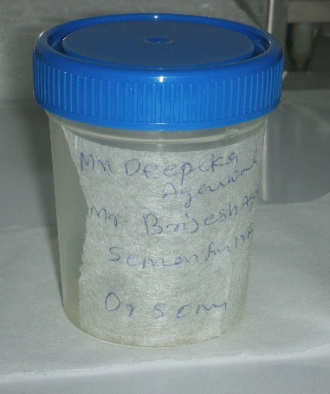

Slide 7
CRYOPRESERVATION –
IF NEEDED
VISCOUS, REDUCED VOLUME
2-3 ml OF CULTURE MEDIUM ADDED

Slide 8
EJACULATORY DYSFUNCTION
RETROGATE EJACULATION
OBJECTIVE:
pH - 7.4
OSMOLARITY- 320 mosm/kg

Slide 9
ORAL INTAKE OF SODIUM BICARBONATE AND WATER
ALTERNATIVELY – CULTURE MEDIUM INJECTED INTO THE BLADDER BEFORE EJACULATION
CENTRIFUGE IMMEDIATELY

Slide 10
ANEJACULATION
PENILE VIBRATORY STIMULATION
ELECTROEJACULATION

Slide 11
LIQUIFICATION
ALLOW TO LIQUIFY NATURALLY - 30-45 mins AT 37⁰C
WHETHER SAMPLE RUNS FREELY ON PIPETTING
VISCOUS SAMPLES ARE DIFFICULT TO PIPETTE
REPEATED ASPIRATION THROUGH THE PIPETTE(with the addition of culture medium)HELPS TO BREAK VISCOSITY

Slide 12
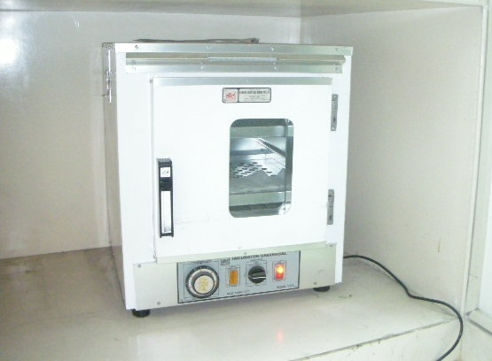

Slide 13
NOTE AND RECORD THE COLOUR
MIX SEMEN THOUROUGHLY
MEASURE THE VOLUME

Slide 14
SEMINAL ANALYSIS
WHO minimum standard,2002
VOLUME 1.5 ml or more
PH >7.2
DENSITY 20m/ml
TOTAL SPERM NO 40 m/ejaculate
MOTILITY > 50% PROGRESSIVE OR >25% RAPIDLY PROGRESSIVE
MORPHOLOGY > 30% NORMAL FORMS
WHITE BLOOD CELLS < 1 million/ml

Slide 15
COUNT AND MOTILITY
FIX DEPTH MAKLER CHAMBER IS USED
COUNT AND MOTILITY IS ASSESED SIMULTANEOUSLY

Slide 16
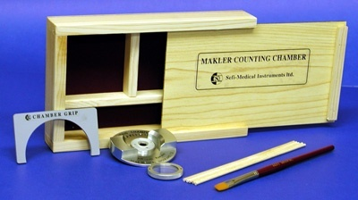
MAKLER CHAMBER

Slide 17
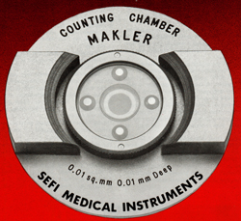
MAKLER CHAMBER

Slide 19
COUNT / ml - TOTAL NUMBER OF SPERMS IN 10 SQUARES
% MOTILITY =(No. OF MOTILE SPERMS IN 10 SQUARES OF CHAMBER)X100 / TOTAL NO. OF SPERMS IN 10 SQUARES

Slide 20
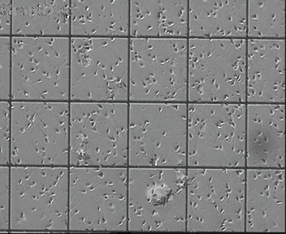

Slide 21
MOTILITY ACCORDING TO WHO
Class a: Rapid,progressive –linear forward progression – 25 microm / sec
Class b: Slow progressive-5 -25 microm /sec
Class c: Non progressive motility(flagellar activity) .
Class d: Immotile (no flagellar activity)

Slide 22
MORPHOLOGY
TYGERBERG STRICT CRITERIA-14%
HEAD SHAPE/SIZE DEFECTS
NECK/MIDPIECE DEFECTS
TAIL DEFECTS

Slide 23
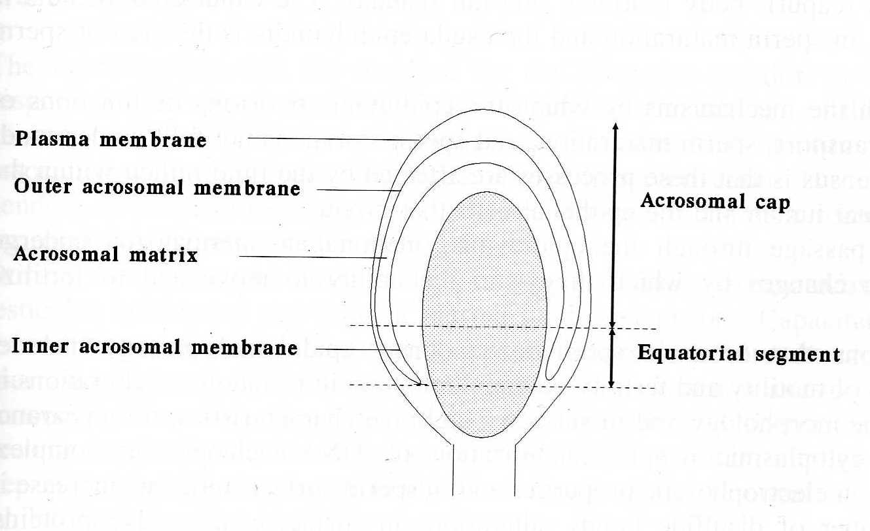

Slide 24
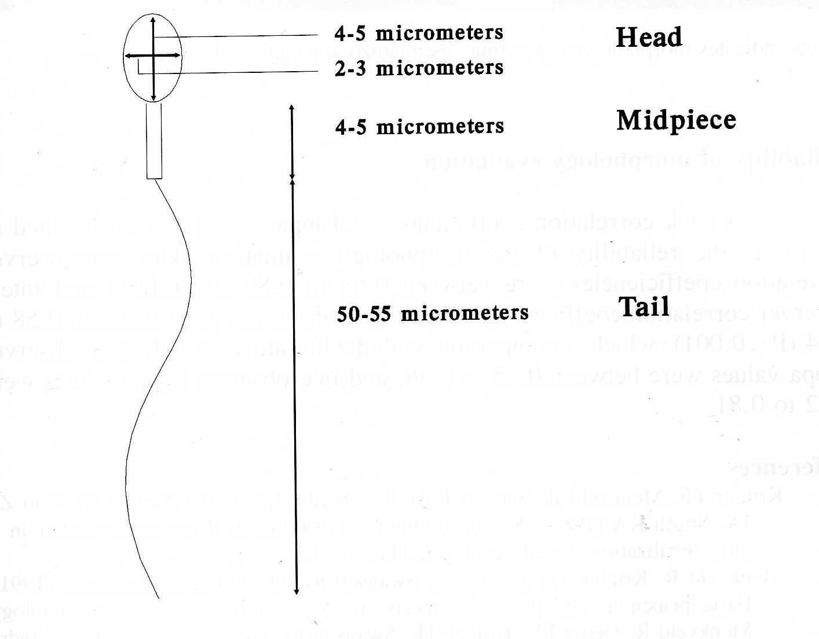

Slide 25
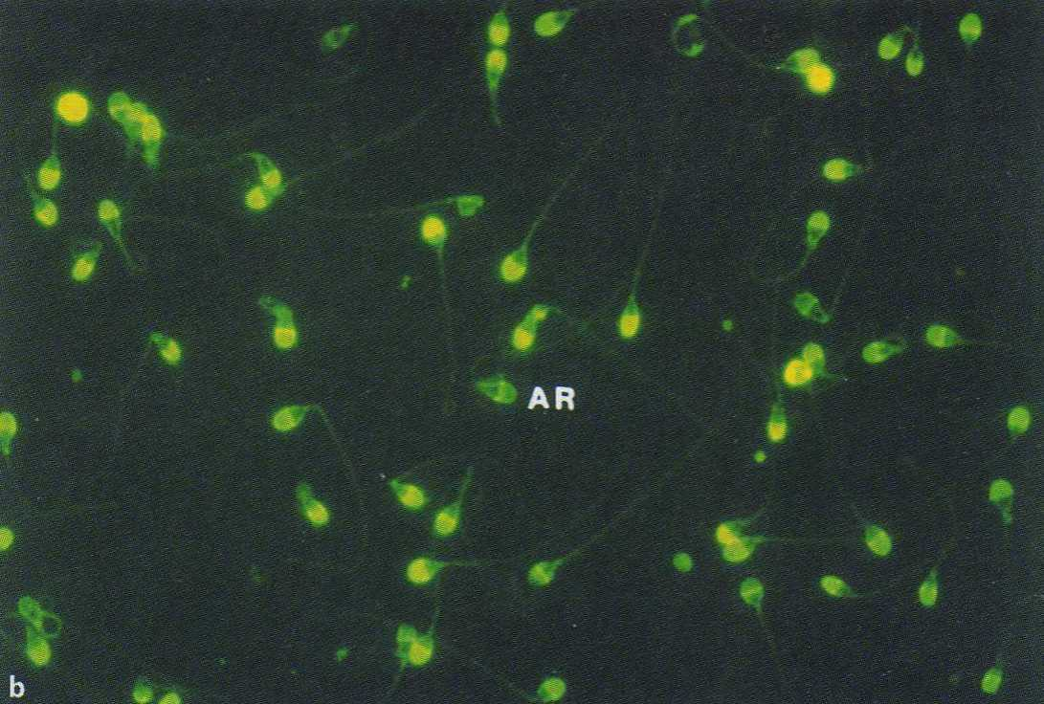

Slide 26
RELATED TO INFERTILITY-
1. GLOBOZOOSPERMIA
2. IMMOTILE CILIA SYNDROME- KARTAGENER SYNDROME

Slide 27
MEDIA
SPERM PREP MEDIA
SPERM RINSE – VITROLIFE(SWEDEN)
GAMETEBUFFER – COOK(AUSTRALIA)
SPERMPREPMEDIA - MEDICULT

Slide 28
BUOYANT DENSITY GRADIENT
PURE SPERM (SCANDINAVIAN IVF)
IXTA PREP (MEDICULT)
SIL SELECT (MICROM)
ISOLATE(IRVINE SCIENTIFIC)

Slide 29
METHODS OF PREPARATION
1. CENTRIFUGATION – SWIM UP
2. SWIM UP FROM SEMEN
3. BUOYANT DENSITY GRADIENT
4. GLASS WOOL FILTRATION
STERILE TECHNIQUE MUST BE FOLLOWED THROUGHOUT

Slide 30
CHOICE OF PREPARATION
DEPENDS ON-
MOTILE COUNT
RATIO BETWEEN MOTILE AND IMMOTILE
VOLUME
VISCOSITY
PRESENCE OF ANTIBODIES,AGLUTINATION,PUS CELLS AND DEBRIS

Slide 31
DIRECT SWIM UP
MOST OF THE SAMPLES CAN BE PROCESSED EXCEPT - WITH LOW MOTILITY AND POOR PROGRESSION
1-1.5 ml OF CULTURE MEDIUM TAKEN IN TWO ROUND BOTTOM TUBES(MULTIPLE TUBES CAN BE USED)
GENTLY PIPETTE 1ml OF LIQUIFIED SEMEN UNDERNEATH MEDIUM

Slide 33
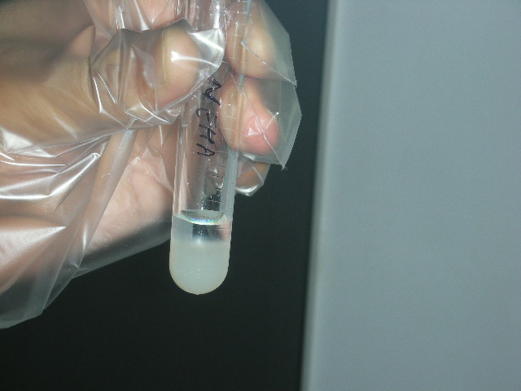

Slide 34
ALLOW TO STAND FOR 30-60 mins AT 37⁰C-
SPERM MIGRATING TO OVERLAID MEDIUM-TURNS OPAQUE OR MILKY
CAREFULLY ASPIRATE ALL THE SUPERNATANT.
CENTRIFUGE COLLECTIVELY IN 15ml CONICAL TUBE AT 1500 – 2000 rpm FOR 10 mins

Slide 35
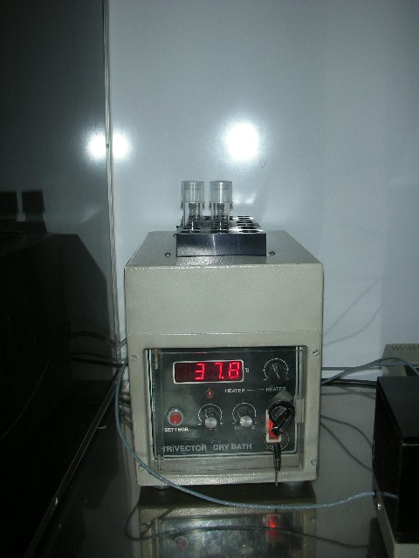

Slide 37
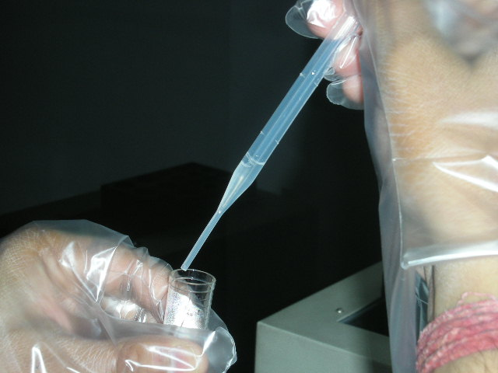
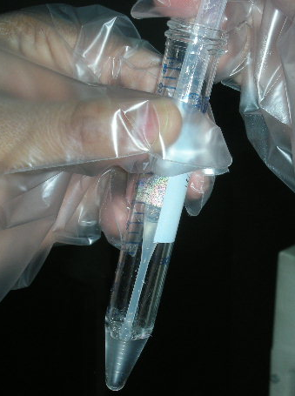

Slide 38
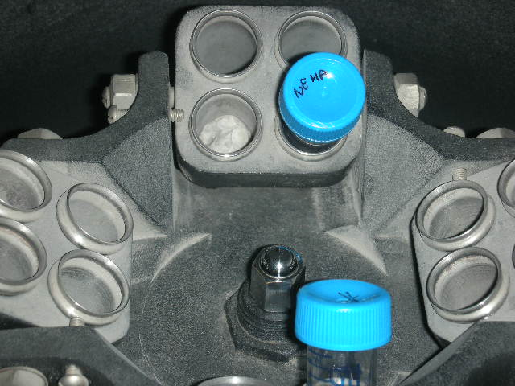
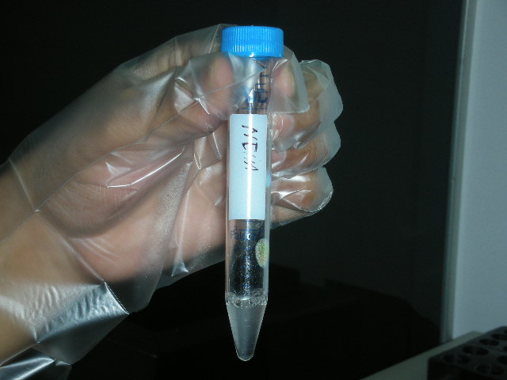

Slide 39
ASPIRATE THE SUPERNATANT – VERY CAREFULLY WITHOUT DISTURBING THE PELLET
AT 0.3 – 0.5ml OF IVF MEDIUM TO THE PELLET AND MIX
LOOK FOR COUNT AND MOTILITY

Slide 40
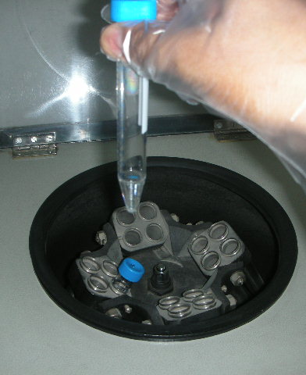
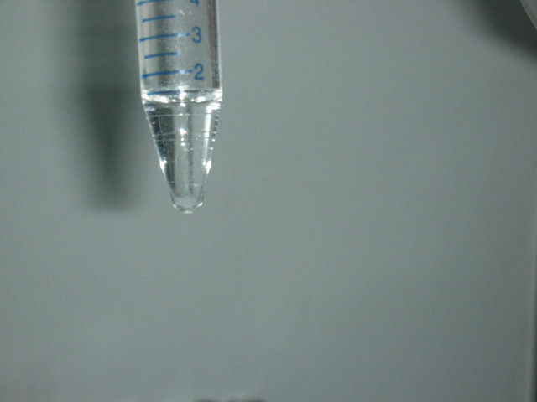

Slide 41
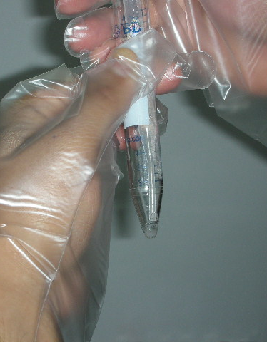
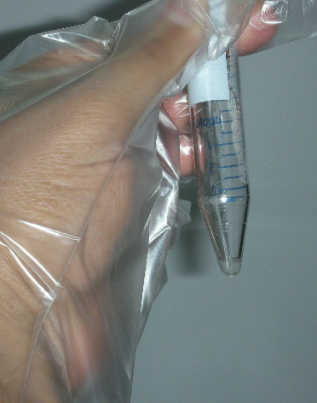

Slide 43
DIRECT SWIM UP
ADVANTAGE -
CENTRIFUGATING ONLY MOTILE SPERMS WITHOUT LEUCOCYTES,DEAD SPERMS AND DEBRIS IN THIS WAY REDUCING THE EFFECT OF ROS
CENTRIFUGATING ONLY ONCE MINIMIZING THE TRAUMA OF CENTRIFUGATION

Slide 44
BUOYANT DENSITY GRADIENT
PREPARED FOR SAMPLES WITH LOW MOTILITY AND POOR PROGRESSION
A TWO LAYERED GRADIENT COLUMN IS PREPARED BY PLACING 1ml OF 90% SOLUTION AT THE BOTTOM OF CONICAL TUBE AND ADDING 1ml OF 45% SOLUTION OVER THE 90%
2 ml OF LIQUIFIED EJACULATE IS LAYERED OVER THE GRADIENT
CENTRIFUGE FOR 10mins AT 2000 rpm

Slide 45
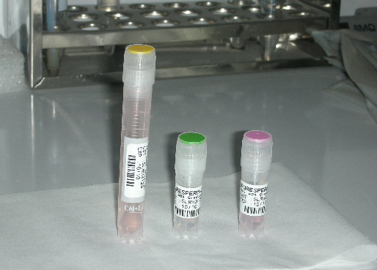

Slide 48
4. REMOVE THE SUPERNATANT , ADD 2 ml OF CULTURE MEDIUM TO THE PELLET AND MIX
5. CENTRIFUGE FOR 10 mins
6. REMOVE THE SUPERNATANT
7.MIX THE PELLET WITH 0.3 – 0.5 ml OF CULTURE MEDIUM

Slide 52
Semen parameters vary from individual to individual and within individual too.
The sample given on the day of procedure can be entirely different from previous assesment

Slide 53
MOST OF THE SAMPLES CAN BE PREPARED BY DIRECT SWIM UP EXCEPT SEMEN WITH LOW MOTILITY AND POOR PROGRESSION WHERE BUYONT DENSITY GRADIENT METHOD IS PREFERRED.

Slide 54
THANK YOU

